Slide 1
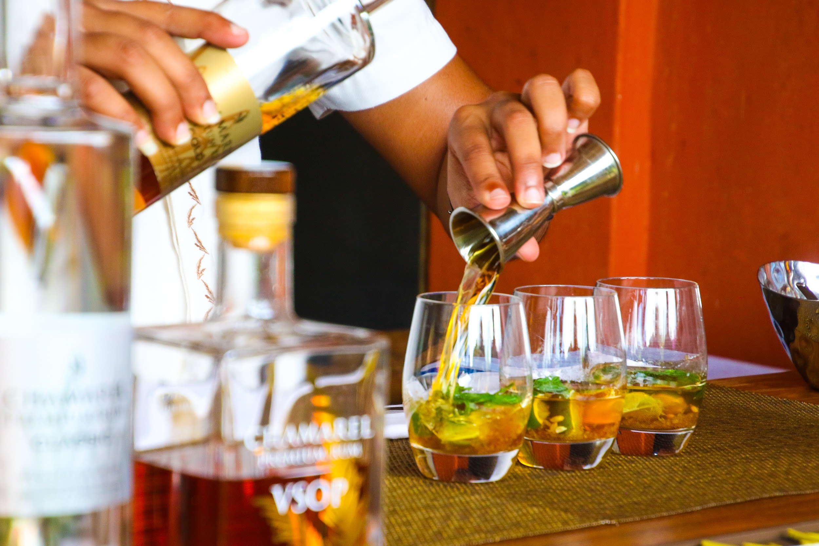
Welcome to
SipAdvisor

Slide 2
The would like to introduce the team behind SipAdvisor
Sebastian Saenz
Cole Weinstein
Brandon Bloodsworth
Dan Hengel

Slide 3
SipAdvisor
The inspiration behind the development of SipAdvior is to provide an application that identifies the ingredients and instructions needed to craft a cocktail being searched by the user.
In addition to this application will provide location of the nearest location to purchase ingredients needed for identified cocktail.

Slide 4

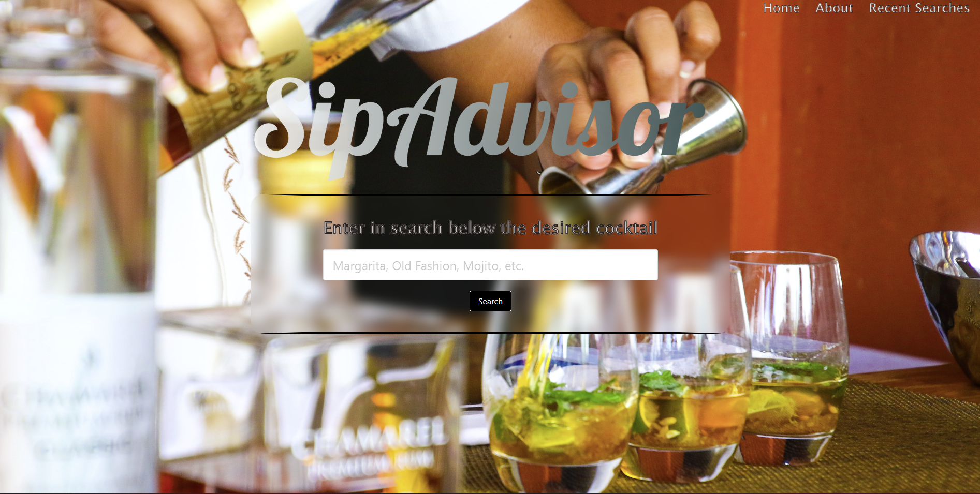
SipAdvisor
SipAdvisor utilizes the following Application Programming Interfaces :
GoogleMaps
TheCocktailDB

Slide 5
SipAdvisor
Questions?
On behalf of
Sebastian, Cole, Brandon & Dan
Thank you

